Slide 1
Career Development Buddy Project Overview
Shehryar Afgan (SP19-BCS-033) | Shah Fahad (FA18-BSE-080)

Slide 2
Project Goals
Help students who are seeking admission in universities for undergraduate degree.
Universities recommendation
Entry test preparation
One-stop admission guidance
Choosing a career path
Mini Job portal

Slide 3
Scope
Aptitude test corresponding to student background to help students choose a career path.
Universities recommendations based on student academic background, interests and preferred location.
Helping in getting prepared for universities entry test.
Mock Tests
Learning Material
Discussion form
Past papers

Slide 4
Scope (contd.)
One-Stop Admission Check
Universities where user can apply according to academic background.
Helping in getting information regarding admission via single page.
Chat-bot
Job Portal
Student applies for job(s) created by employer.
Audio/Video Call sessions for remote interviews for an applied job.

Slide 5
Modules
User Profiling
Aptitude Test
Institute Recommendation
Entry test preparation
Chatbot
One-Stop admission check
Job Portal
Virtual Sessions

Slide 6
Tools and technology
Front-End:
React JS
CSS (BootStrap)
JavaScript
Back-End:
MongoDB
Node
Express
Google DialogFlow (Chatbot)
Kommunicate (Chatbot)
Python (Scikit-Learn for ML model)

Slide 7
Actors
Student
Employer
Admin

Slide 8
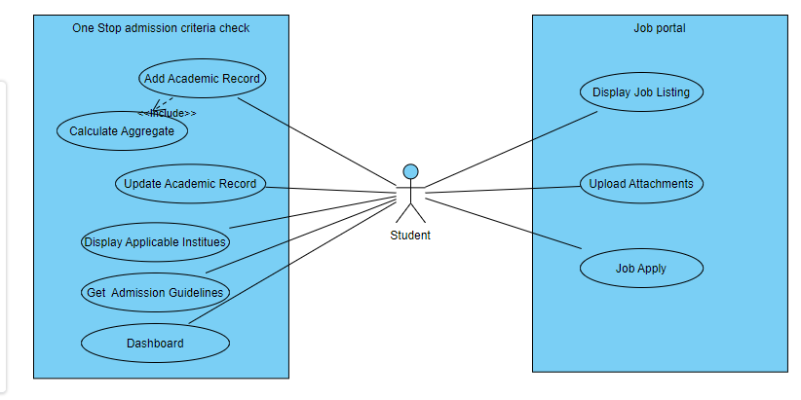
Student Use-Case (1/3)

Slide 9
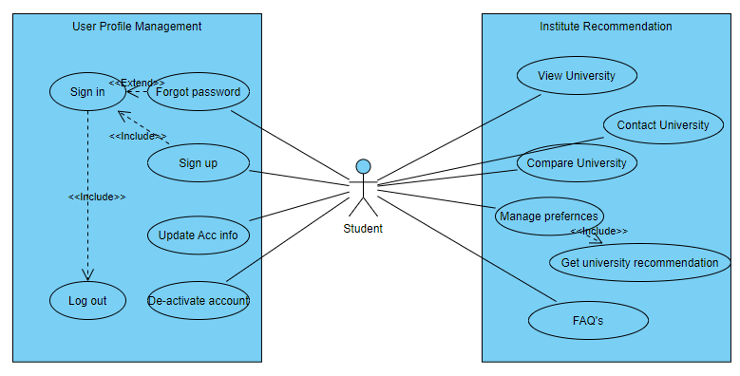
Student Use-Case (2/3)

Slide 10
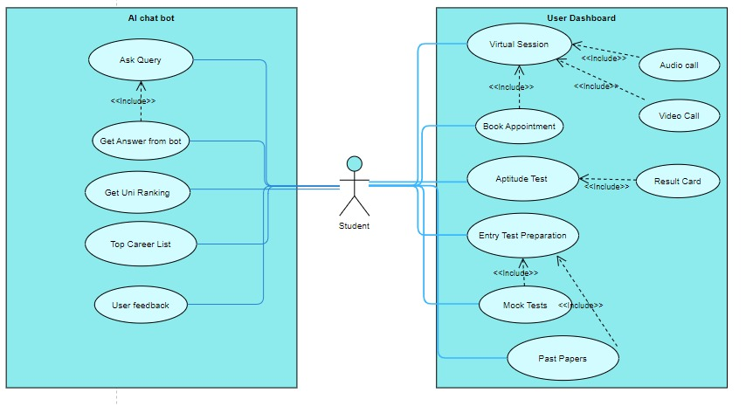
Student Use-Case (3/3)

Slide 11
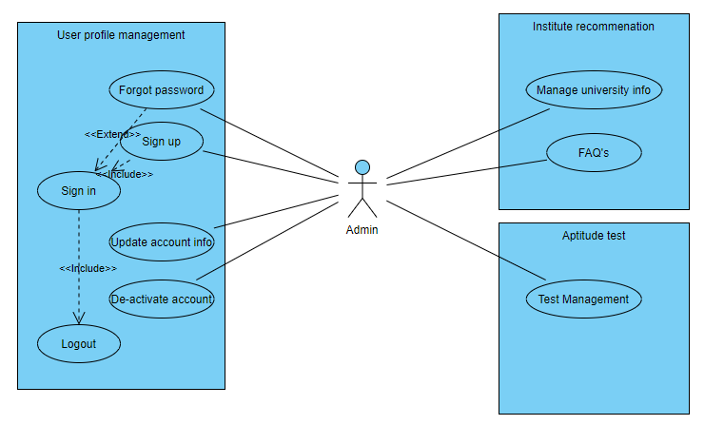
Admin Use-Case (1/2)

Slide 12
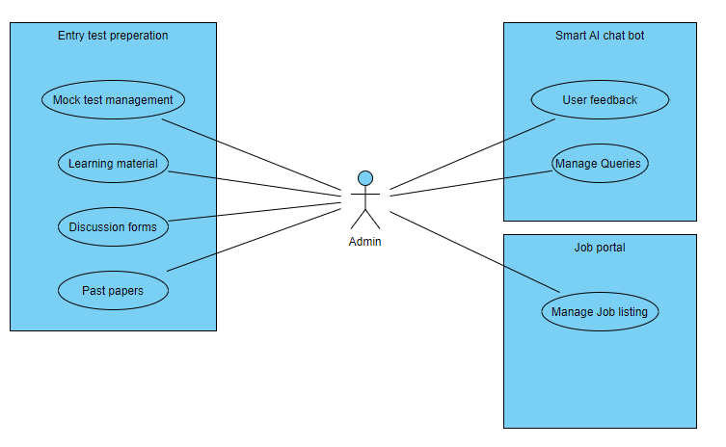
Admin Use-Case (2/2)

Slide 13
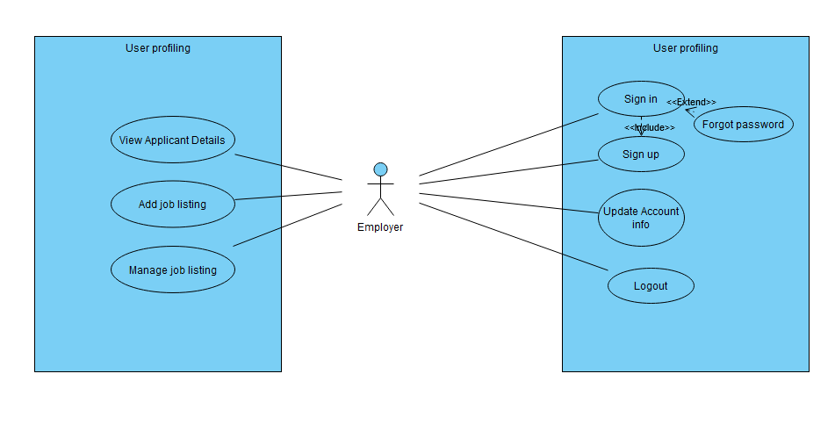
Employer Use-Case (1/2)

Slide 14
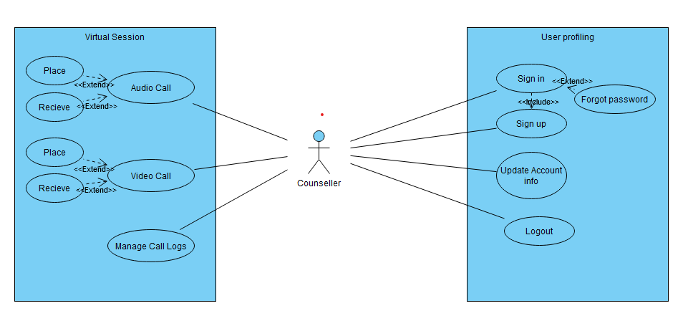
Employer Use-Case (2/2)

